Slide 1

Digital Image Fundamental
Dr. S.Kandar
Assistant Professor
Department of Information Technology
IIEST, Shibpur

Slide 2
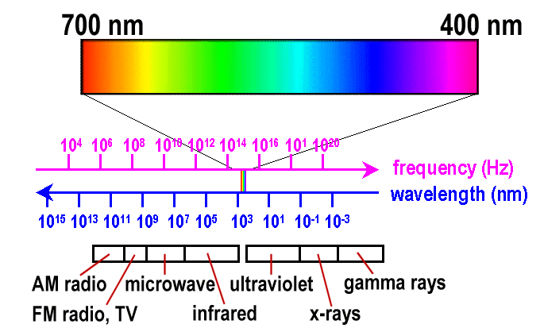
Human and Computer Vision
Human vision system
Images are observed, evaluated and processed by our visual system
Color | Wavelength | Frequency
violet | 380–450 nm | 668–789 THz
blue | 450–495 nm | 606–668 THz
green | 495–570 nm | 526–606 THz
yellow | 570–590 nm | 508–526 THz
orange | 590–620 nm | 484–508 THz
red | 620–750 nm | 400–484 THz

Slide 3
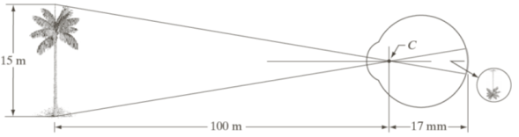
Image formation in eye
image is formed on the retina
formed by two types preceptors
Cones: highly sensitive to color (photopic or bright light vision)
Rods: give general and overview picture of scene (scotopic or dim light vision)

Slide 4
Intensity, Brightness and Contrast
Intensity and brightness are two different phenomena
Intensity is the measure of energy of a wave
a numerical value which represents a pixel
Brightness is relative term perceived by human visual system
Described as sensation to light intensity
Not just a simple function of intensity
Contrast may be considered as difference of perceived brightness

Slide 5

Mach Band Pattern
Brightness is not same for same intensity value in our visual system ----an optical illution
Some times overshoot or undershoot
For boundary region’s intensity variation
Scalloped near the boundaries
Named after
Ernst Mach,
described the
phenomena in
1865

Slide 6
Simultaneous Contrast
Contrast sensitivity of the eye refers to the ratio of the difference in brightness of an object and brightness of its immediate surrounding
All four small squares have same intensity, but they appear to be darker progressively as the background becomes brighter.
Region’s perceived brightness does not depend simply on its intensity.

Slide 7



Examples of optical illusion
Eye fills non-existing information
Or
wrongly perceives geometrical properties of the object

Slide 8
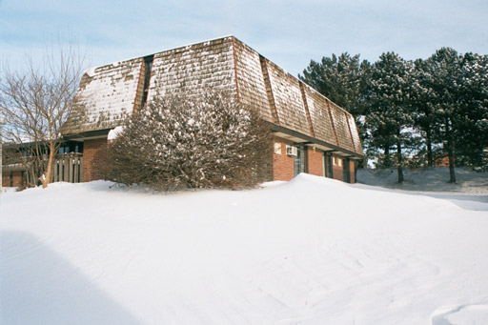
Fundamentals of Digital Images
y
Origin
x
Image “After snow storm”
f(x,y)
w An image: a multidimensional function of spatial coordinates.
w Spatial coordinate: (x,y) for 2D case such as photograph,
(x,y,z) for 3D case such as CT scan images
(x,y,t) for movies
w The function f may represent intensity (for monochrome images)
or color (for color images).

Slide 9
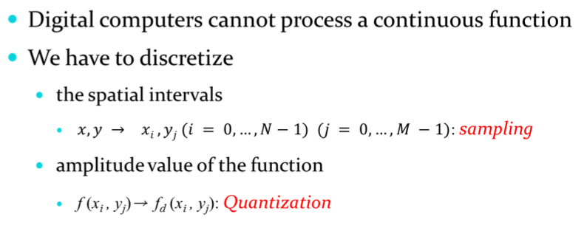
Digital Images
Digital image: A digital image is discretized both in Spatial coordinates and Amplitude levels.
w Consist of 2 sets:(i) a point (position) set and (ii) an amplitude set.
w Can be represented in the form
I = {(x, f(x)): x∈X, f(x) ∈ F}
where X and F are a point set and amplitude set, respectively.
w An element of the image, (x, f(x)) is called a pixel where
- x is called the pixel location and
- f(x) is the pixel value at the location x

Slide 10
Digital Images
Digital image: An image may be considered as a two dimensional function f(x,y), where x and y are spatial coordinates and the amplitude of f at any pair of coordinates (x, y) is called the intensity or gray level of the image at that point.
w When x, y and f are finite and discrete quantities, we call the image as digital image.
Objective of DIP stems from two principal applications
(i) improvement of pictorial information for human perception
(ii) processing of image data for storage, transmission and representation for autonomous machine perception

Slide 11
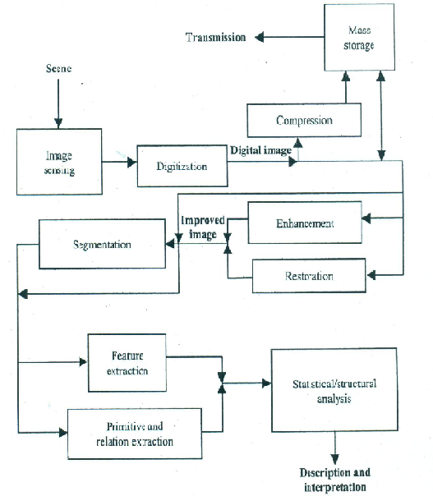
Steps in DIP
Discretize and representation low-level
Processing Mid-level
Analysis High-level
w

Slide 12
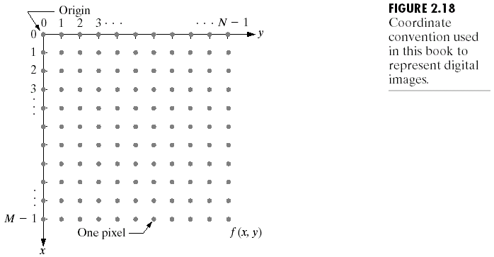
Coordinate Convention
(Images from Rafael C. Gonzalez and Richard E.
Wood, Digital Image Processing, 2nd Edition.

Slide 13
Image as Matrices
; M×N matrix
f (x, y)=i(x,y).r(x,y)
; a_{ij}= f (x=i, y=j)

Slide 14
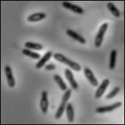
Digital Image Types : Intensity Image
Intensity image or monochrome image
each pixel corresponds to light intensity normally represented in gray scale (gray level).
Gray scale values

Slide 15
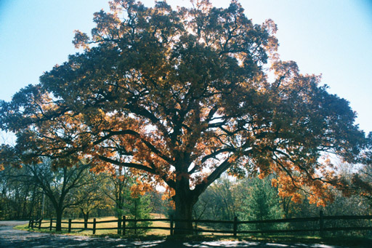
Digital Image Types : RGB Image
Color image or RGB image:
each pixel contains a vector
representing red, green and
blue components.
RGB components

Slide 16

Image Types : Binary Image
Binary image or black and white image
Each pixel contains one bit :
1 represent white
0 represents black
Binary data

Slide 17
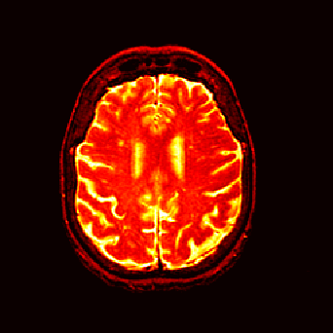
Image Types : Index Image
Index image
Each pixel contains index number
pointing to a color in a color table
Color Table
Index No. | Red component | Green component | Blue component
1 | 0.1 | 0.5 | 0.3
2 | 1.0 | 0.0 | 0.0
3 | 0.0 | 1.0 | 0.0
4 | 0.5 | 0.5 | 0.5
5 | 0.2 | 0.8 | 0.9
… | … | … | …
Index value

Slide 18
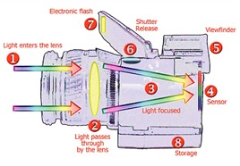
Digital Image Acquisition Process

Slide 19
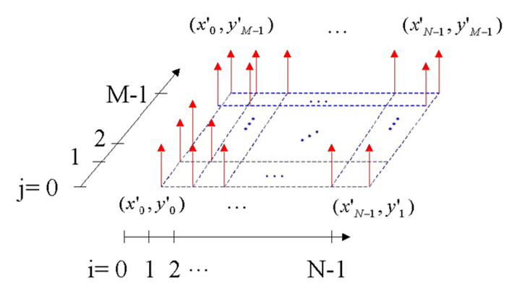
Sampling

Slide 20
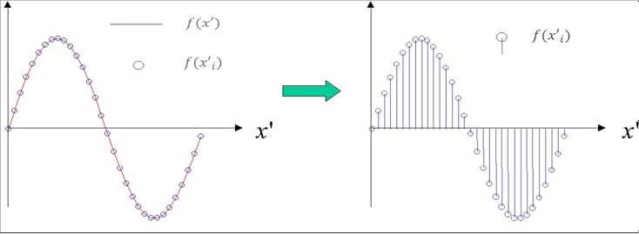
Sampling

Slide 21
Sampling
Continuous image
Intensity value along the scan line AB
Sampling and quantization
Digital scan line
a
b
c
d

Slide 22
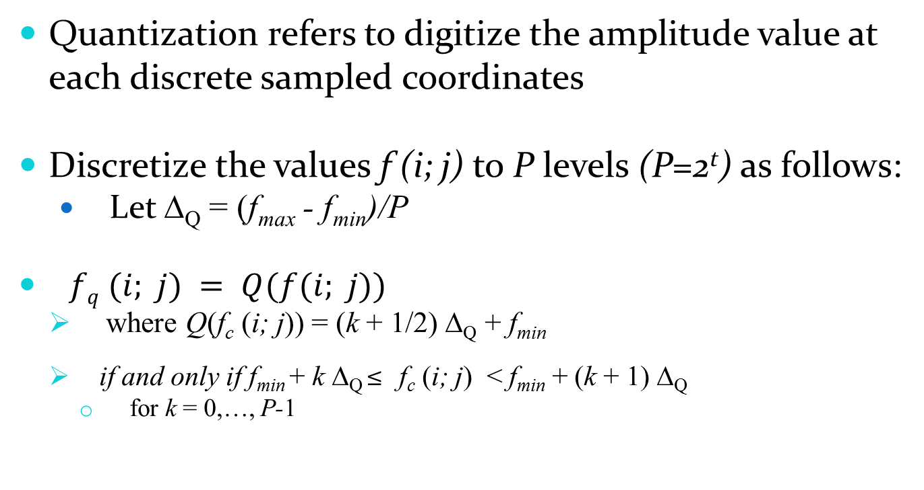
Quantization
Quantization refers to digitize the amplitude value at each discrete sampled coordinates
Discretize the values f (i; j) to P levels (P=2^{t}) as follows:
Let Δ_{Q}= (f_{max} - f_{min})/P
$fq (i; j) = Q(f(i; j))$
where Q(f_{c} (i; j)) = (k + 1/2) Δ_{Q} + f_{min}
if and only if f_{min}+ k Δ_{Q} ≤f_{c} (i; j) <f_{min}+ (k + 1) Δ_{Q}
for k = 0,…, P-1

Slide 23
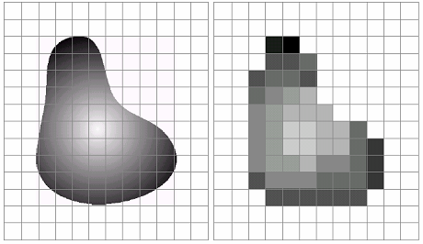
Example of sampling and Quantization
Continuous image projected onto a sensor array
Result of image sampling and quantization

Slide 24
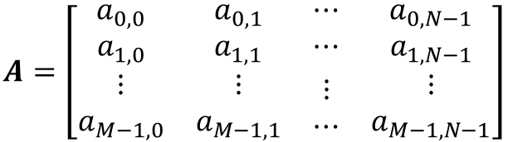
Digital Image Representation
A digital image can be considered a matrix whose row and column indices identify a point in the image and the corresponding matrix element value identifies the gray level at that point
$$A=\left[\begin{matrix}\begin{matrix}a_{0,0} & a_{0,1} & ⋯ \\ a_{1,0} & a_{1,1} & ⋯ \\ \begin{aligned}⋮ \\ a_{M−1,0}\end{aligned} & \begin{aligned}⋮ \\ a_{M−1,1}\end{aligned} & \begin{aligned}⋮ \\ ⋯\end{aligned}\end{matrix} & \begin{matrix}a_{0,N−1} \\ a_{1,N−1} \\ \begin{aligned}⋮ \\ a_{M−1,N−1}\end{aligned}\end{matrix}\end{matrix}\right]$$
Image as matrix

Slide 25
Spatial and Intensity Resolution
Spatial resolution refers to
Smallest discernible detail of an image
Pixels (dots) per unit distance
dpi - dot per inch, lpi, ppi
Line pair per unit distance
Intensity resolution refers to
Smallest discernible change in intensity level
number of intensity levels used to represent the image.
Commonly number of bits to quantize intensity level
Higher the intensity level, higher the image quality and higher the size of image.

Slide 26
How to choose the spatial resolution
Spatial resolution
= Sampling locations
Original image
Sampled image
Under sampling, we lost some image details!

Slide 27
How to choose the spatial resolution : Nyquist Rate
Sampled image
Original image
2mm
1mm
No detail is lost!
Minimum
Period
Nyquist Rate:
Spatial resolution must be less or equal
half of the minimum period of the image
or sampling frequency must be greater or
Equal twice of the maximum frequency.
Spatial resolution
(sampling rate)
= Sampling locations

Slide 28
Aliased Frequency
an undesired effect in which the sampling frequency is too low to accurately reproduce the original analog content, resulting in signal distortion.
Sampling rate:
5 samples/sec
Two different frequencies but the same results !

Slide 29
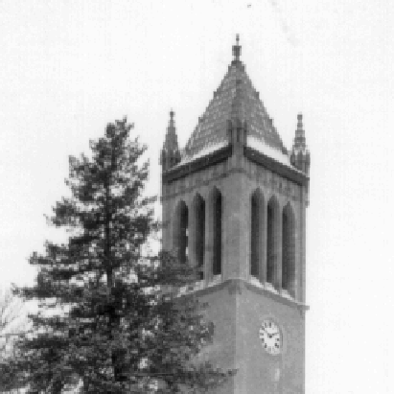
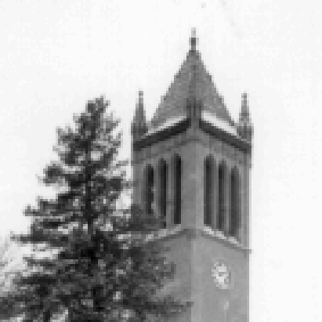

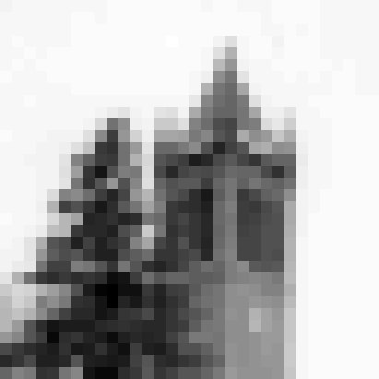
Effect of Spatial Resolution
256x256 pixels
128x128 pixels
64x64 pixels
32x32 pixels

Slide 30
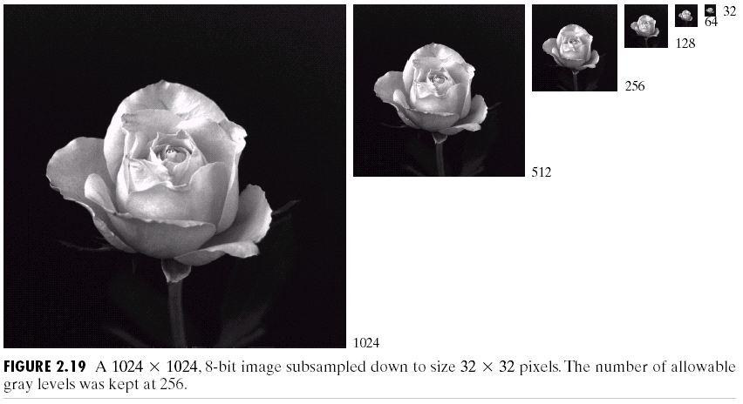
Effect of Spatial Resolution
(Images from Rafael C. Gonzalez and Richard E.
Wood, Digital Image Processing, 2nd Edition.

Slide 31
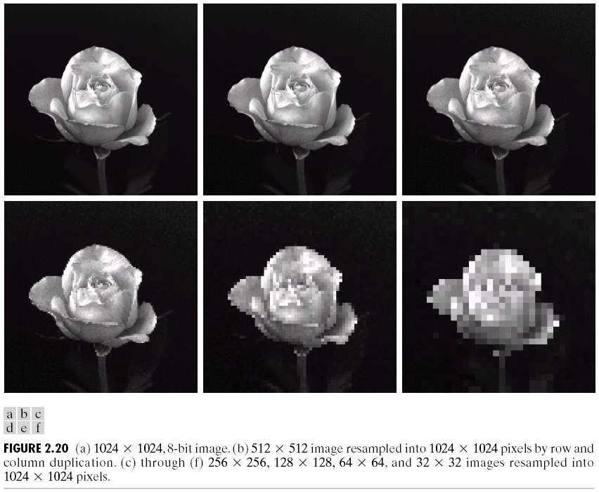
Effect of Spatial Resolution
(Images from Rafael C. Gonzalez and Richard E.
Wood, Digital Image Processing, 2nd Edition.

Slide 32
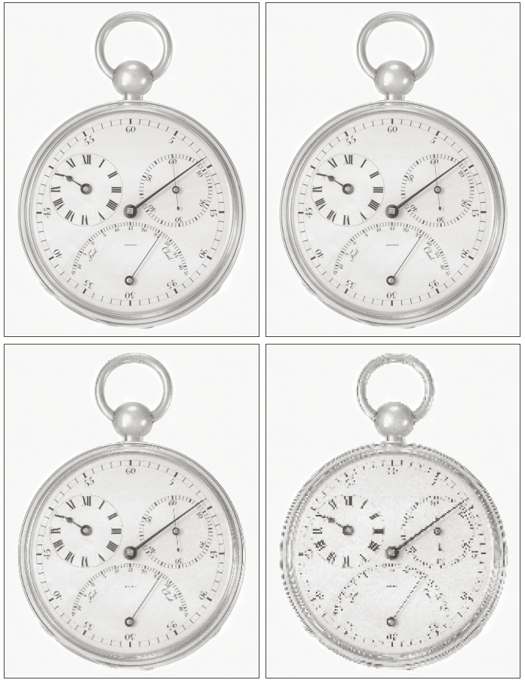
Effect of reducing spatial resolution
(a) 1250 dpi
(b) 300 dpi
(c) 150 dpi
(d) 72 dpi
a
b
c
d

Slide 33
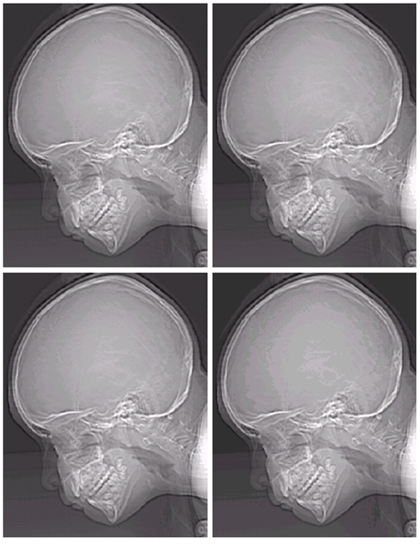
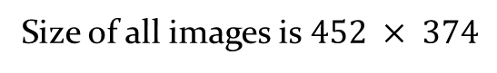
Effect of reducing level of intensity level
256 gray level
(b) 128 gray level
(c) 64 gray level
(d) 32 gray level
a
b
c
d
Size of all images is $452 × 374$

Slide 34
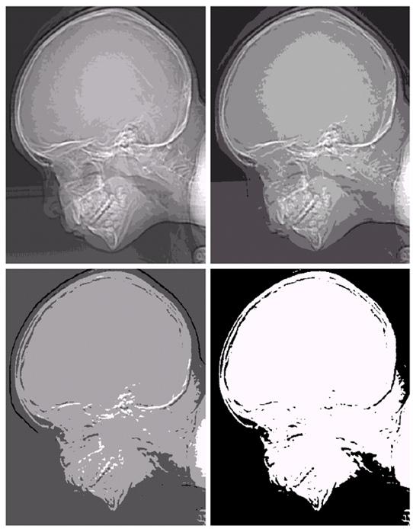
Effect of reducing level of intensity level (contd.)
(e) 16 gray level
(f) 8 gray level
(g) 4 gray level
(h) 2 gray level
a
e
f
b
g
h
c
d
Size of all images is $452 × 374$

Slide 35
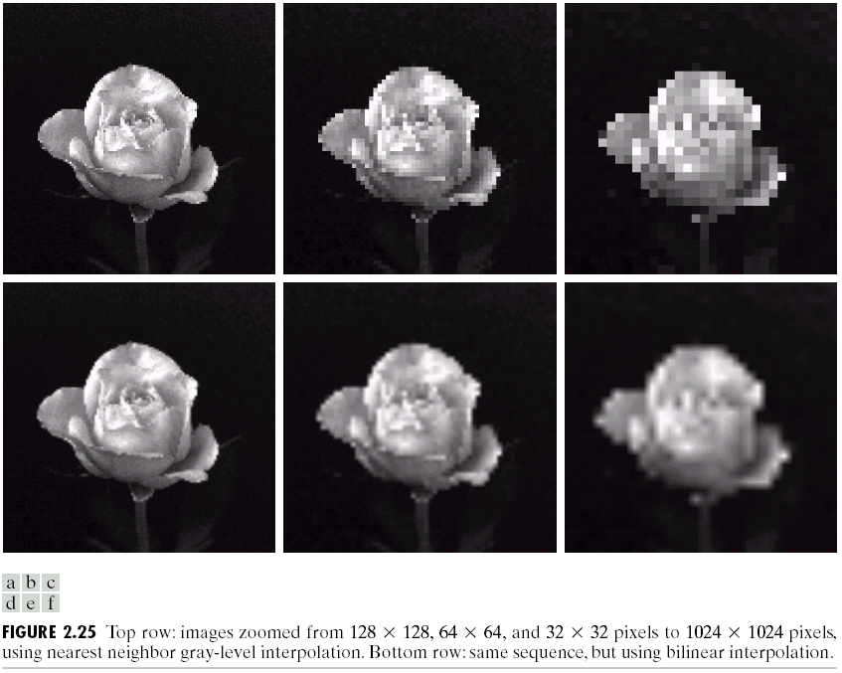
Can we increase spatial resolution by interpolation ?
Down sampling is an irreversible process.
(Images from Rafael C. Gonzalez and Richard E.
Wood, Digital Image Processing, 2nd Edition.

Slide 36
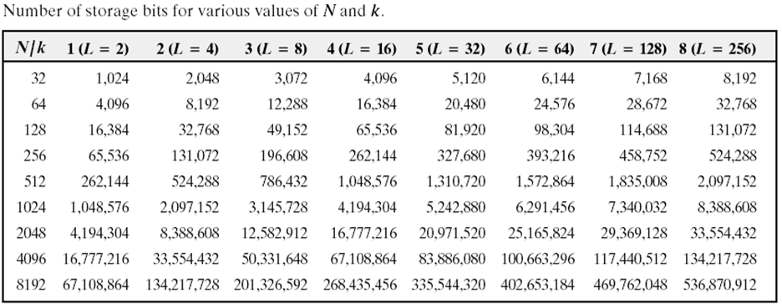
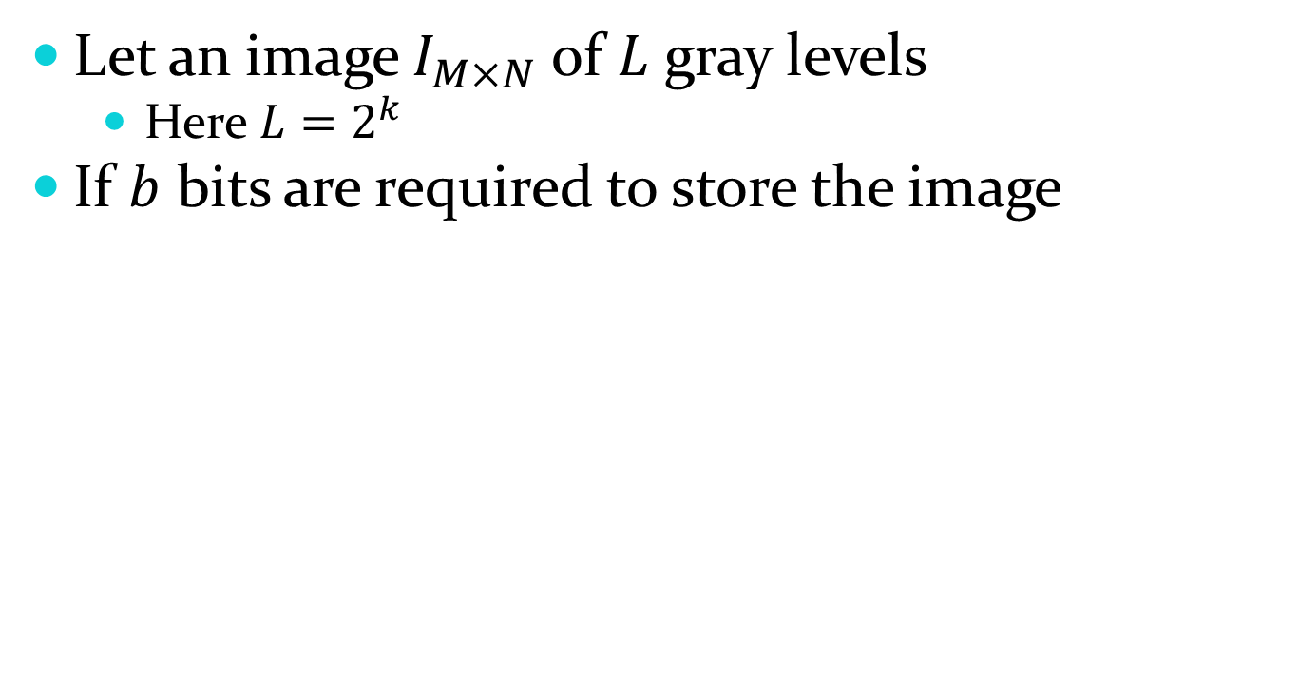
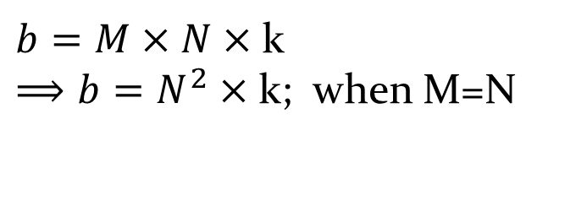
Storage space for digital image
Let an image $I_{M×N}$ of $L$ gray levels
Here $L=2^{k}$
If $b$ bits are required to store the image
$b=M×N×$ k
$⟹b=N^{2}×$ k; when M=N

Slide 37
Basic relationship between pixels
Neighbors of pixel
Adjacency, connectivity, regions and boundaries
Distance measures
Arithmetic/logical operations

Slide 38
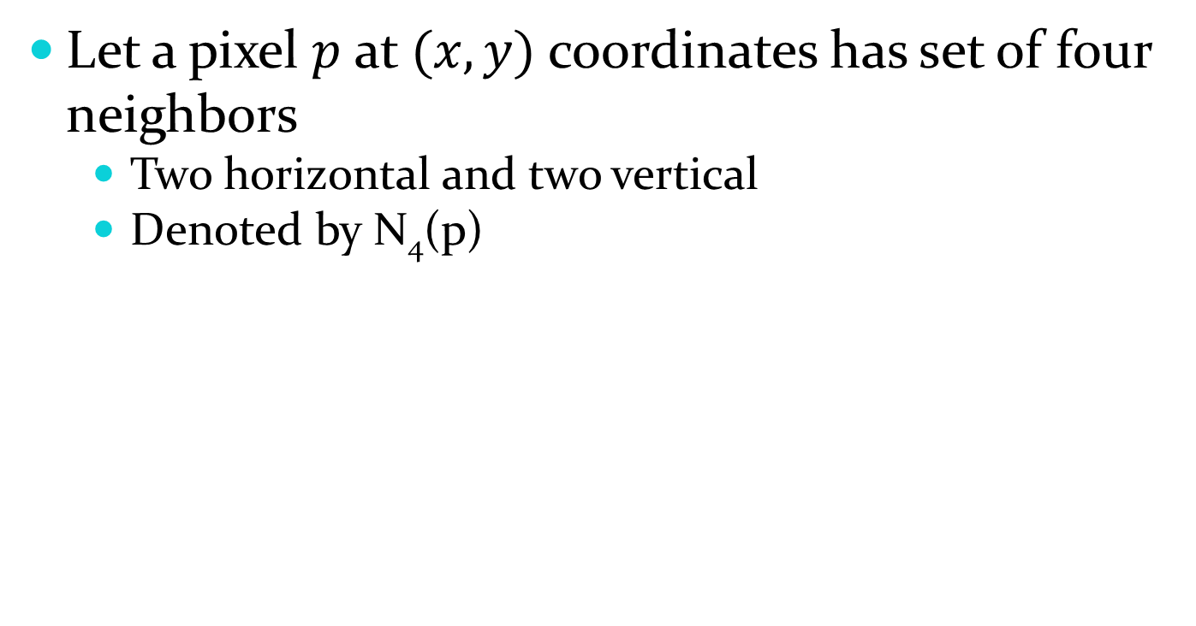
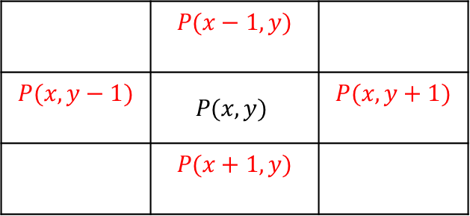
Neighbors of pixel N₄(p)
Let a pixel $p$ at $(x,y)$ coordinates has set of four neighbors
Two horizontal and two vertical
Denoted by N₄(p)
 | $$P(x−1,y)$$
$$P(x,y−1)$$ | $$P(x,y)$$ | $$P(x,y+1)$$
 | $$P(x+1,y)$$

Slide 39
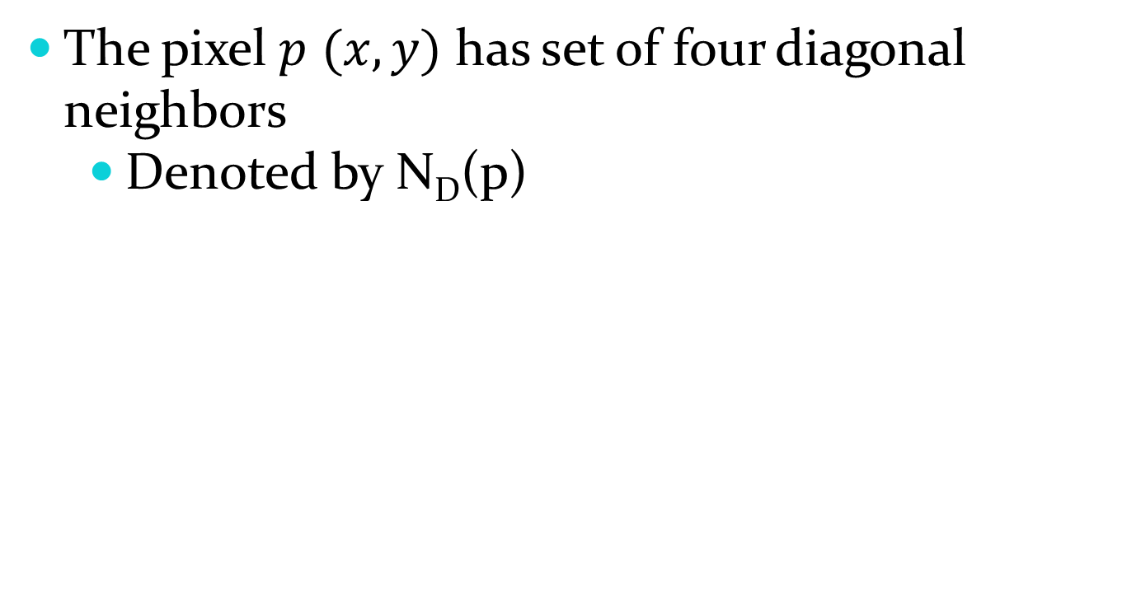
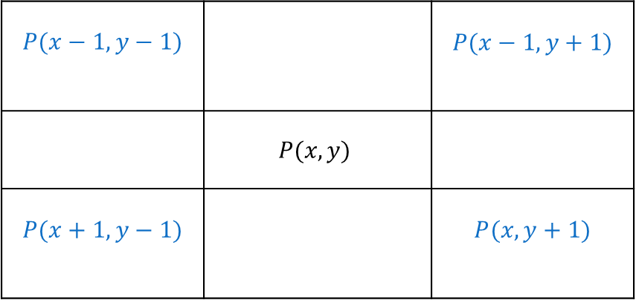
Neighbors of pixel N_{D}(p)
The pixel $p$$(x,y)$ has set of four diagonal neighbors
Denoted by N_{D}(p)
$$P(x−1,y−1)$$ |  | $$P(x−1,y+1)$$
 | $$P(x,y)$$
$$P(x+1,y−1)$$ |  | $$P(x,y+1)$$

Slide 40

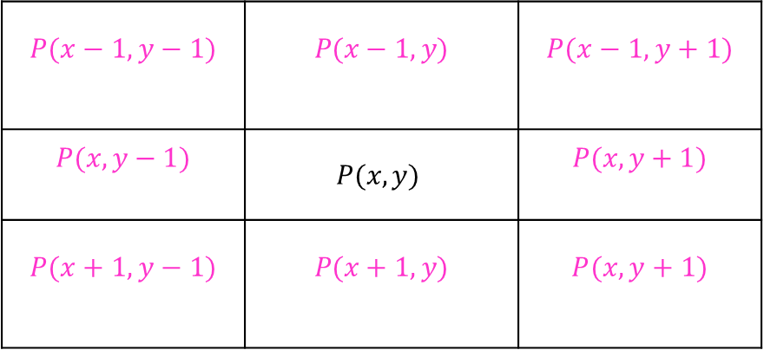
Neighbors of pixel N₈(p)
The four neighbor pixels and four diagonal pixels are called 8-neighbors of $p$
Denoted by N₈(p)
$$P(x−1,y−1)$$ | $$P(x−1,y)$$ | $$P(x−1,y+1)$$
$$P(x,y−1)$$ | $$P(x,y)$$ | $$P(x,y+1)$$
$$P(x+1,y−1)$$ | $$P(x+1,y)$$ | $$P(x,y+1)$$

Slide 41
Neighbors of pixel N₈(p)
Let V is the set of gray level values used to define adjacency
4-adjacency: two pixels p and q with values from set V are 4-adjacent if
q is in the set N₄(p)
8-adjacency: two pixels p and q with values from set V are 8-adjacent if
q is in the set N₈(p)
m-adjacency: two pixels p and q with values from set V are m-adjacent if
q is in the set N₄(p), or
q is in the set N_{d}(p) and set N₄(p) ∩ N₄(q) has no pixels whose values are from V

Slide 42
Adjacency of pixels
V={1,2,3,4,5,6,7,8,9,10}
{3} 4-adj.
{1,3,7,9} 8-adj.
{3} m-adj. (I)
{9} m-adj. (II)
{7} not m-adj. By {II}
{11,13,18,15} not adj.
1 | 3 | 7
11 | 6 | 13
18 | 15 | 9

Slide 43
Adjacency (contd.)
0 1 1
0 1 0
0 0 1
0 1 1
0 1 0
0 0 1
0 1 1
0 1 0
0 0 1
a b c
m-adjacent (8-path ambiguous) m-path no ambiguous

Slide 44
Adjacency
A pixel p is adjacent to pixel q if they are connected.
Two image subsets S₁ and S₂ are adjacent if some pixel
in S₁ is adjacent to some pixel in S₂
S₁
S₂
We can define type of adjacency: 4-adjacency, 8-adjacency
or m-adjacency depending on type of connectivity.

Slide 45
Path
A path from pixel p at (x,y) to pixel q at (s,t) is a sequence
of distinct pixels:
(x₀,y₀), (x₁,y₁), (x₂,y₂),…, (x_{n},y_{n})
such that
(x₀,y₀) = (x,y) and (x_{n},y_{n}) = (s,t)
and
(x_{i},y_{i}) is adjacent to (x_{i-1},y_{i-1}), i = 1,…,n
q
p
We can define type of path: 4-path, 8-path or m-path
depending on type of adjacency.

Slide 46
Path (cont.)
8-path
m-path
p
p
p
q
q
q
m-path from p to q
solves this ambiguity
8-path from p to q
results in some ambiguity

Slide 47
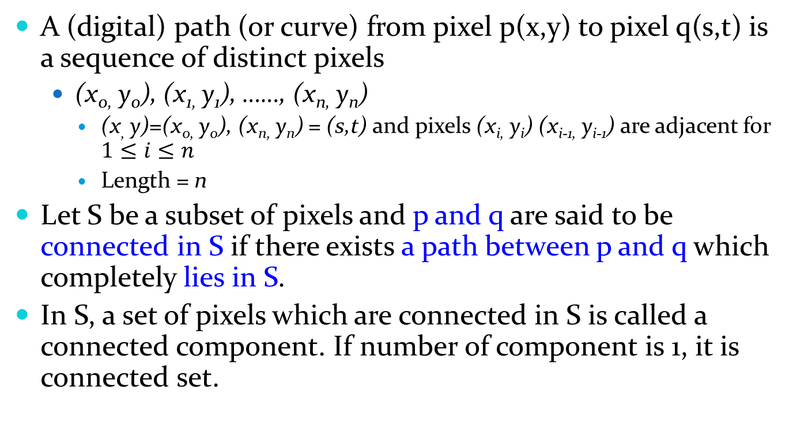
Definitions
A (digital) path (or curve) from pixel p(x,y) to pixel q(s,t) is a sequence of distinct pixels
(x_{0,} y₀), (x_{1,} y₁), ……, (x_{n,}y_{n})
(x, y)=(x_{0,} y₀), (x_{n,}y_{n}) = (s,t) and pixels (x_{i,}y_{i}) (x_{i-1,} y_{i-1}) are adjacent for $1≤i≤n$
Length = n
Let S be a subset of pixels and p and q are said to be connected in S if there exists a path between p and q which completely lies in S.
In S, a set of pixels which are connected in S is called a connected component. If number of component is 1, it is connected set.

Slide 48
Definitions
Let R be a subset of pixels in an image. We call R is a region if R is a connected set
Suppose an image contains k disjoint regions R_{k}, k=1,2, ….k
R_{u} denote the union of all the k regions (foreground)
(R_{u})^{c} denote its complement (background)
Boundary (border or contour) of a region is a set of pixels in the region that have one or more neighbors that are not member of the region.

Slide 49
Labeling of Connected Components (4-connected) [binary]
Scan the image from left to right
Let p denote the pixel at any step in the scanning process.
Let r denote the upper neighbor of p.
Let t denote the left-hand neighbors of p.
when we get to p, points r and t have already been encountered and labeled if they were 1’s.
 | r
t | p

Slide 50
Labeling of Connected Components
if the value of p = 0, move on.
if the value of p = 1, examine r and t.
if they are both 0, assign a new label to p.
if only one of them is 1, assign its label to p.
if they are both 1
if they have the same label, assign that label to p.
if not, assign one of the labels to p and make a note that the two labels are equivalent. (r and t are connected through p).
at the end of the scan, all points with value 1 have been labeled.
do a second scan, assign a new label for each equivalent labels.

Slide 51
Component labeling (4)
0 0 0 0 0 0 0 0
0 1 1 0 0 1 1 1
0 1 1 0 0 0 1 1
0 1 1 0 0 0 0 0
0 0 0 1 1 0 0 0
0 0 0 1 1 0 0 0
0 0 0 1 1 0 0 0
0 0 0 0 0 0 0 0
0 0 0 0 0 0 0 0
0 1 1 0 0 3 3 3
0 1 1 0 0 0 3 3
0 1 1 0 0 0 0 0
0 0 0 2 2 0 0 0
0 0 0 2 2 0 0 0
0 0 0 2 2 0 0 0
0 0 0 0 0 0 0 0
1 1 1 0 1 0 0 0
0 0 1 1 1 0 0 0
0 1 1 0 0 0 0 0
0 0 0 0 0 0 0 0
1 1 1 0 1 1 0 0
1 1 1 0 0 1 1 0
0 0 0 0 0 1 1 1
0 0 0 0 0 0 0 0
1 1 1 0 1 0 0 0
0 0 1 1 1 0 0 0
0 1 1 0 0 0 0 0
0 0 0 0 0 0 0 0
2 2 2 0 3 3 0 0
2 2 2 0 0 3 3 0
0 0 0 0 0 3 3 3
0 0 0 0 0 0 0 0

Slide 52
Labeling of Connected Components (8-connected)
do the same way but examine also the upper diagonal neighbors of p.
if p is 0, move on.
if p is 1
if all four neighbors are 0, assign a new label to p.
if only one of the neighbors is 1, assign its label to p.
if two or more neighbors are 1, assign one of the label to p and make a note of equivalent classes.
do the second round and introduce a unique label to each equivalent class.

Slide 53
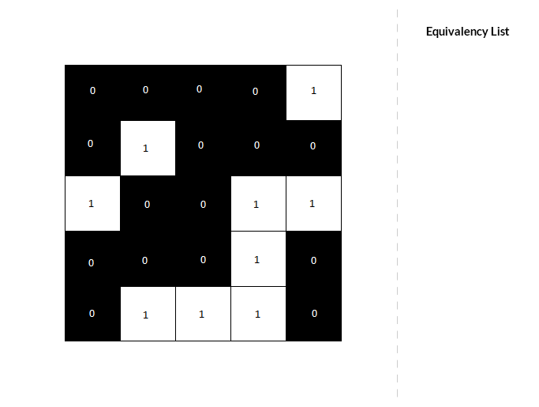

Slide 54


Slide 55
Component labeling (8)
0 0 0 0 0 0 0 0
0 1 1 0 0 1 1 1
0 1 1 0 0 0 1 1
0 1 1 0 0 0 0 0
0 0 0 1 1 0 0 0
0 0 0 1 1 0 0 0
0 0 0 1 1 0 0 0
0 0 0 0 0 0 0 0
0 0 0 0 0 0 0 0
0 1 1 0 0 2 2 2
0 1 1 0 0 0 2 2
0 1 1 0 0 0 0 0
0 0 0 1 1 0 0 0
0 0 0 1 1 0 0 0
0 0 0 1 1 0 0 0
0 0 0 0 0 0 0 0
1 1 1 0 1 0 0 0
0 0 1 1 1 0 0 0
0 1 1 0 0 0 0 0
0 0 0 0 0 0 0 0
1 1 1 0 1 1 0 0
1 1 1 0 0 1 1 0
0 0 0 0 0 1 1 1
0 0 0 0 0 0 0 0
1 1 1 0 1 0 0 0
0 0 1 1 1 0 0 0
0 1 1 0 0 0 0 0
0 0 0 0 0 0 0 0
2 2 2 0 3 3 0 0
2 2 2 0 0 3 3 0
0 0 0 0 0 3 3 3
0 0 0 0 0 0 0 0

Slide 56
Distances between pixels
For pixels p, q and z say, (x,y), (s,t) and (v,w) be the locations. The distance function is
D(p,q) >=0 ( =0 if p=q)
D(p,q) = D(q,p)
D(p,z)<= D(p,q) + D(q,z)
Euclidean distance D_{e} (p,q) =

Slide 57
Distance (cont.)
D₄-distance (city-block distance) is defined as
2
2
1
2
2
1
0
1
2
2
1
2
2
Pixels with D₄(p) = 1 is 4-neighbors of p.

Slide 58
Distance (cont.)
D₈-distance (chessboard distance) is defined as
2
2
2
2
2
2
1
1
1
2
2
1
0
1
2
2
1
1
1
2
2
2
2
2
2
Pixels with D₈(p) = 1 is 8-neighbors of p.

Slide 59
Zooming
Zooming is process to enlarge image
It can be viewed as oversampling
Step 1: creates new pixel locations
Step 2: assignment of gray levels to these new locations
New pixel value is assigned by nearest pixel value in the original image
This is called nearest neighbor interpolation (NNI)

Slide 60
Zooming (contd...)
Pixel replication, using nearest neighbor interpolation applicable
When image size is increased by integer number of times
For instance to double image
Duplicate each row and column once in vertical and horizontal direction
Duplication is done the required number of times for dezired size
20 | 50
30 | 10
20 | 20 | 50 | 50
20 | 20 | 50 | 50
30 | 30 | 10 | 10
30 | 30 | 10 | 10

Slide 61
Zooming (contd...)
NNI is fast method but it has undesirable effect that is called chess board effect
Chess board is visible at high factor of magnification
To overcome the drawback bilinear interpolation is used
Where four nearest neighbor pixels values are considered
For bilinear interpolation the pixel value is assigned by
f(x,y) = ax+by+cxy+d
Where f(x,y) is gray level of zoomed image at (x,y) and a,b,c are d are four neighbor pixel’s gray level

Slide 62
Zooming (contd...)
a b c zoomed to 1024x1024 from 128x128
64x64 32x32 nearest neighbor interpolation
d e f
by using bilinear interpolation

Slide 63
Shrinking
Shrinking is done by same manner as zooming but in reverse order
Pixel replication done by
Row-column deletion
Expand the grid and determine the intensity
Either by NNI, or
Bilinear interpolation

Slide 64
References
Rafael Gonzalez , Richard Woods , Digital Image Processing, 4th Edition, Pearson

